Slide 1
Chapter 11:Cryptographic Hash Functions
Freshman Seminar
2022.01.25
Sumin Sohn

Slide 2
Contents
11.1 Applications of Cryptographic Hash Functions
11.2 Two Simple Hash Functions
11.3 Requirements and Security
11.4 Hash Functions Based on CBC
11.5 SHA

Slide 3
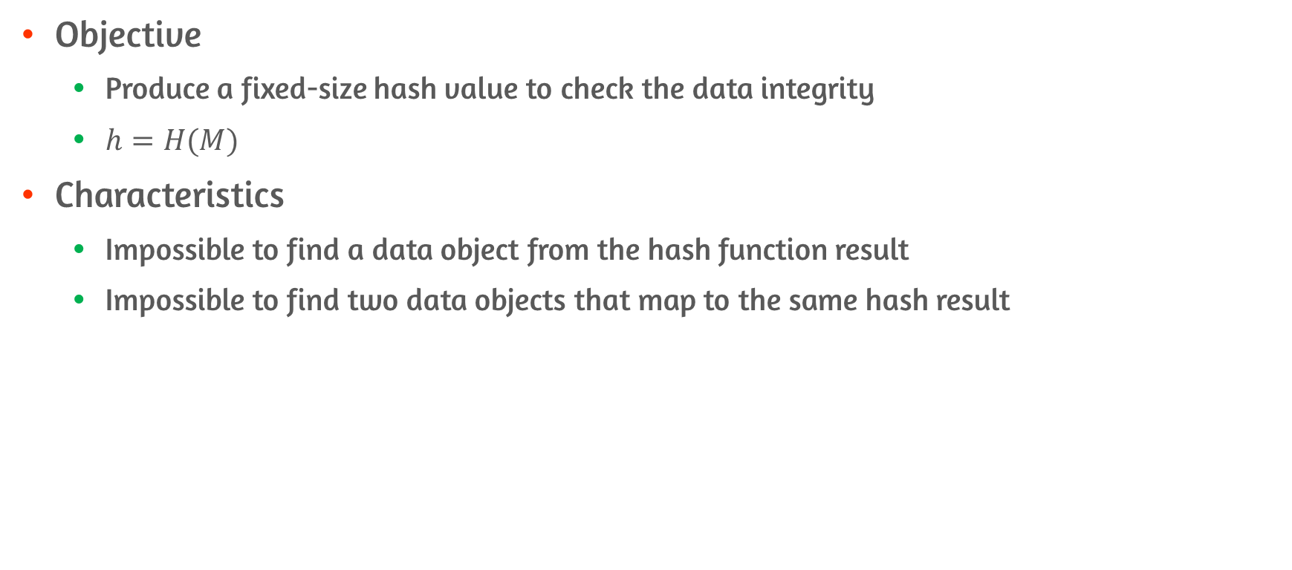
Cryptographic Hash Functions
Objective
Produce a fixed-size hash value to check the data integrity
$h=H(M)$
Characteristics
Impossible to find a data object from the hash function result
Impossible to find two data objects that map to the same hash result

Slide 4
11.1 Applications of Cryptographic Hash Functions

Slide 5
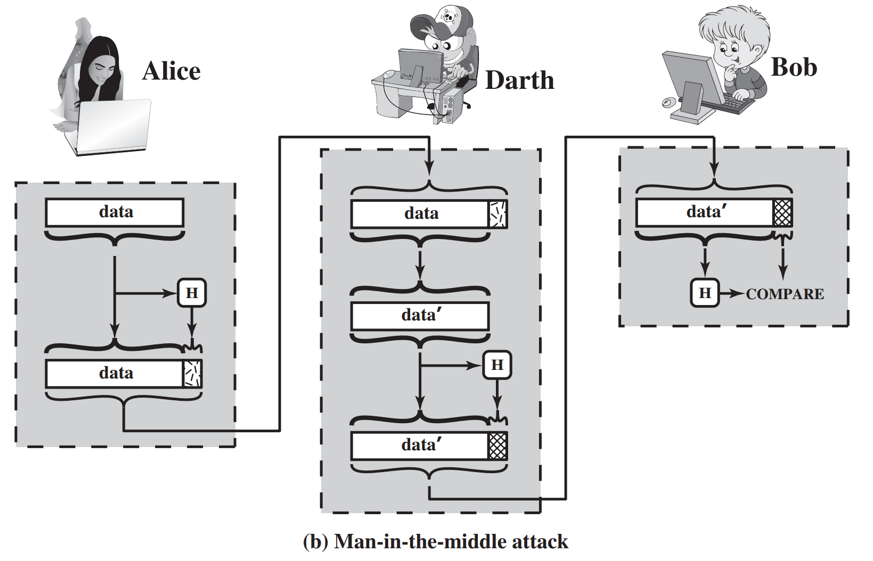
Message Authentication
Meaning
A mechanism or service used to verify the integrity of a message
Used to check the data integrity
Possible danger
Hash value must be protected in a secure fashion
Attacker could change the data if data not protected

Slide 6
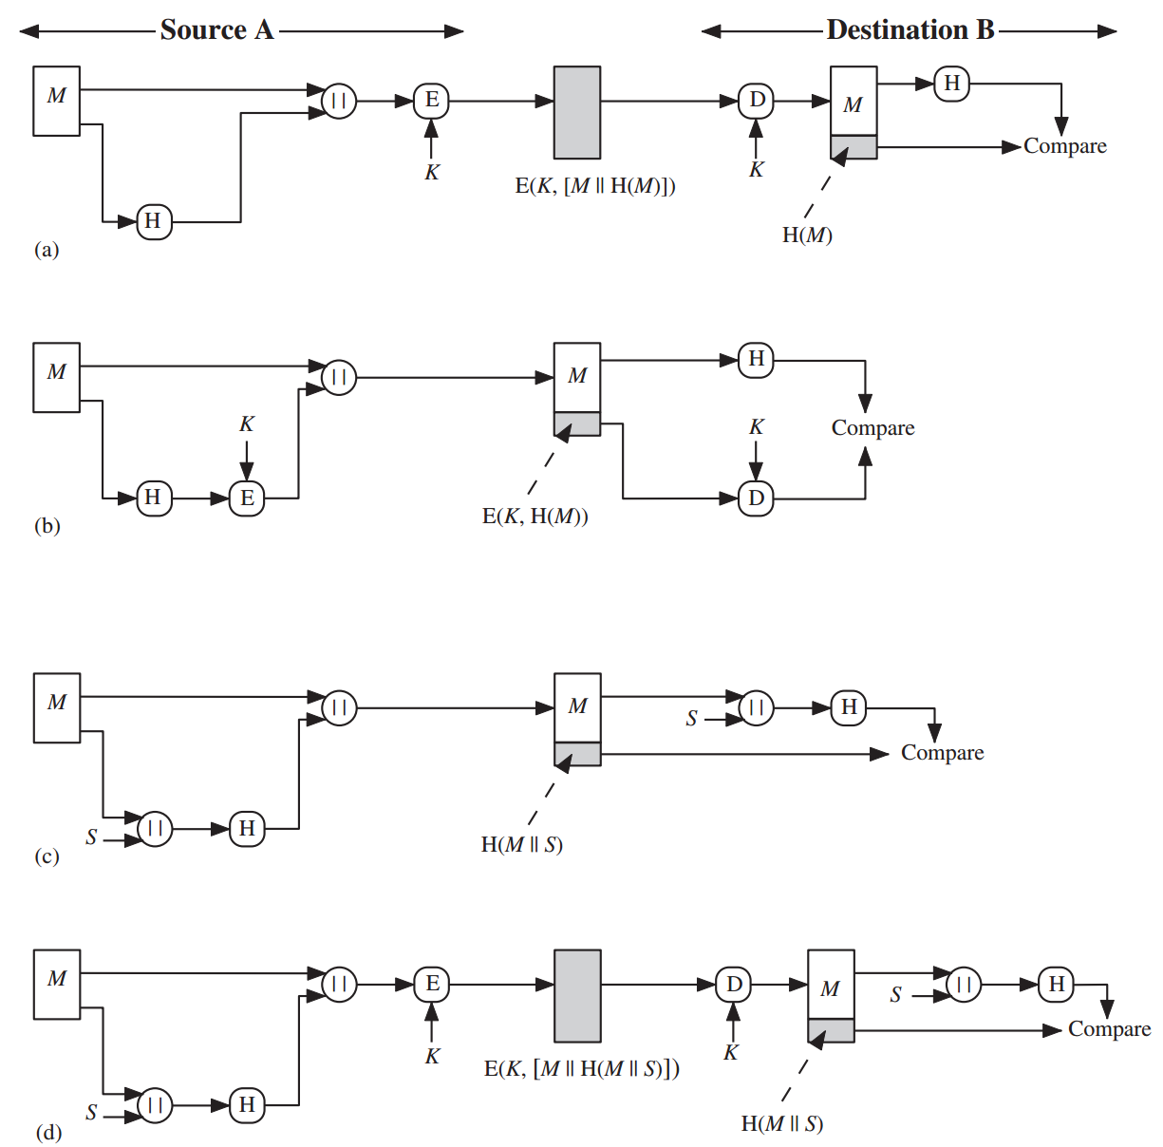
Examples of Message Authentication
Concatenate hash code the encrypt
Confidentiality and Authentication provided
Only hash code encrypt
Only provide Authentication
Use a hash function with secret value S
Opponent can not intercept S is known to only sender and recipient
Disadvantages of Encryption
Encryption is slow
Encryption may be covered by patents

Slide 7
Message Authentication Code
Keyed hash function
Combination of hashing and encryption
Always produce fixed size output that is secure

Slide 8
Digital Signatures
The hash value of a message is encrypted with a private key
Verify the signature with a public key
Procedure
Hash code is encrypted using private key
Only the sender could encrypt
Using symmetric key provides confidentiality

Slide 9
Other Applications
One-way password file
Hash of password file is stored instead of password itself
Intrusion/virus detection
Store valid hashed value of certain file and detect possible modification
Pseudorandom number
Hash function can be used to produce random number

Slide 10
11.2 Two Simple Hash Functions

Slide 11
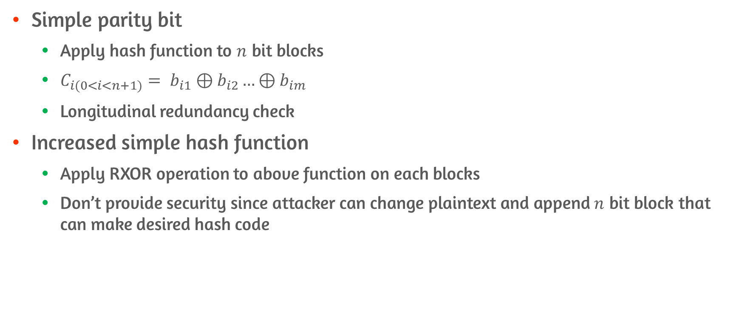
Principles of TSHF
Simple parity bit
Apply hash function to $n$ bit blocks
$C_{i(0<i<n+1)}= b_{i1}⊕b_{i2}…⊕b_{im}$
Longitudinal redundancy check
Increased simple hash function
Apply RXOR operation to above function on each blocks
Don’t provide security since attacker can change plaintext and append $n$ bit block that can make desired hash code

Slide 12
11.3 Requirements and Security

Slide 13
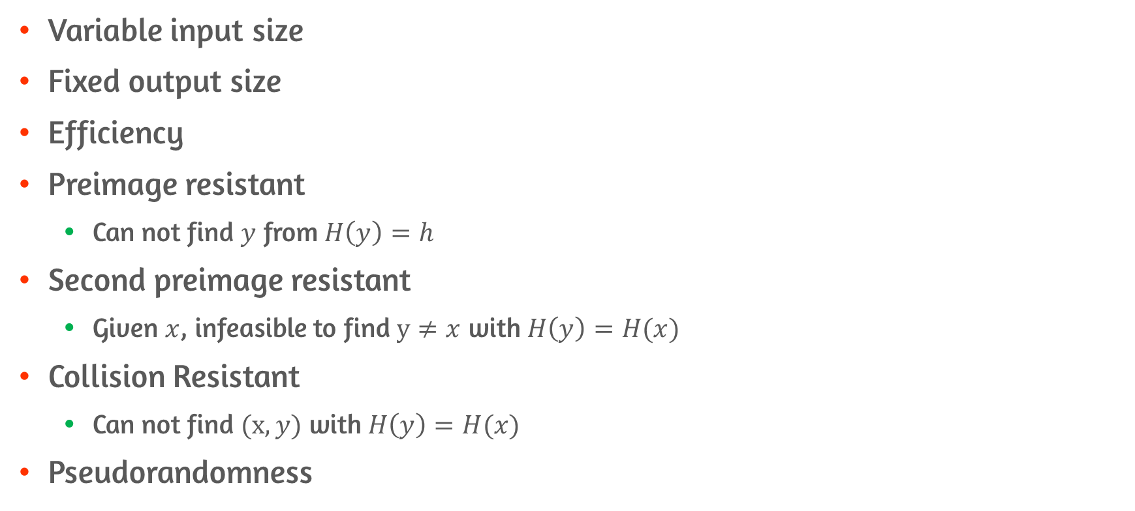
Requirements
Variable input size
Fixed output size
Efficiency
Preimage resistant
Can not find $y$ from $H\left(y\right)=h$
Second preimage resistant
Given $x$, infeasible to find $y≠x$ with $H\left(y\right)=H(x)$
Collision Resistant
Can not find $(x,y)$ with $H\left(y\right)=H(x)$
Pseudorandomness

Slide 14
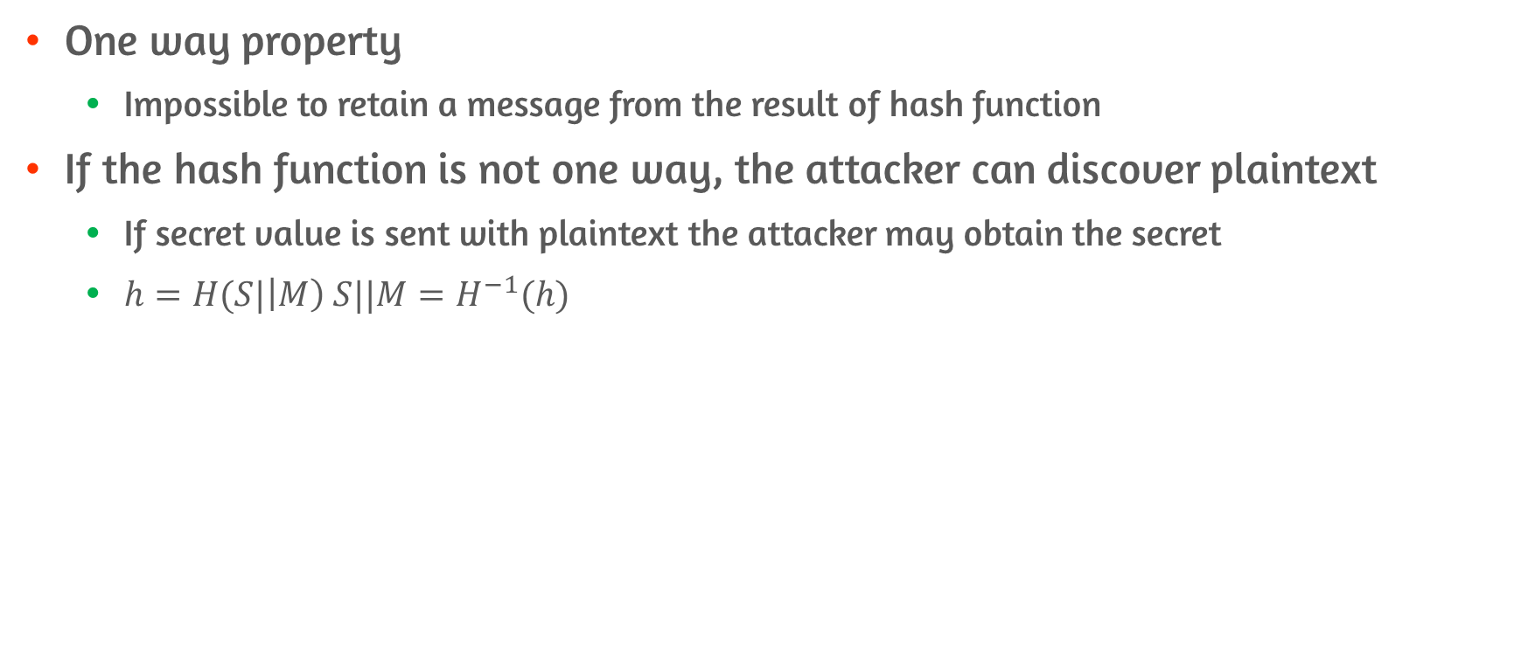
Preimage Resistant
One way property
Impossible to retain a message from the result of hash function
If the hash function is not one way, the attacker can discover plaintext
If secret value is sent with plaintext the attacker may obtain the secret
$h=H(S|\left|M\right) S||M=H^{−1}(h)$

Slide 15
Second Preimage Resistant
Infeasible to find an alternative message with the same hash value
This prevents forgery when an encrypted hash code is used
Attacker obtain a message plus its encrypted hash code
Attacker generate unencrypted hash code from a message
Attacker can generate an alternate message with same hash code if second preimage resistant is not provided

Slide 16
Collision Resistant
The final condition to be a strong hash function
E.g., if collision resistant is not provided
Bob writes debt message to Alice
Bob finds two message with the same hash value
One requires small amount money and one requires massive amount of money
Since two hash value is same, Bob can assert Alice signed on second message even though Alice signed on the first message

Slide 17
Pseudorandomness
Cryptographic hash function is used on key derivation and pseudorandom number generation
Three resistant properties depend on the randomness

Slide 18
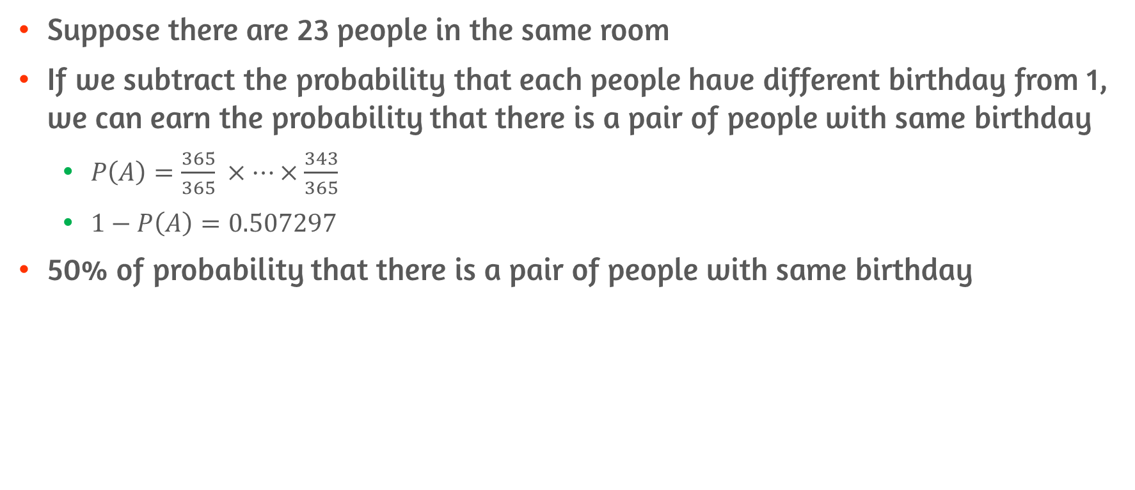
Birthday Paradox
Suppose there are 23 people in the same room
If we subtract the probability that each people have different birthday from 1, we can earn the probability that there is a pair of people with same birthday
$P\left(A\right)=\frac{365}{365} ×…×\frac{343}{365}$
$1−P\left(A\right)=0.507297$
50% of probability that there is a pair of people with same birthday

Slide 19
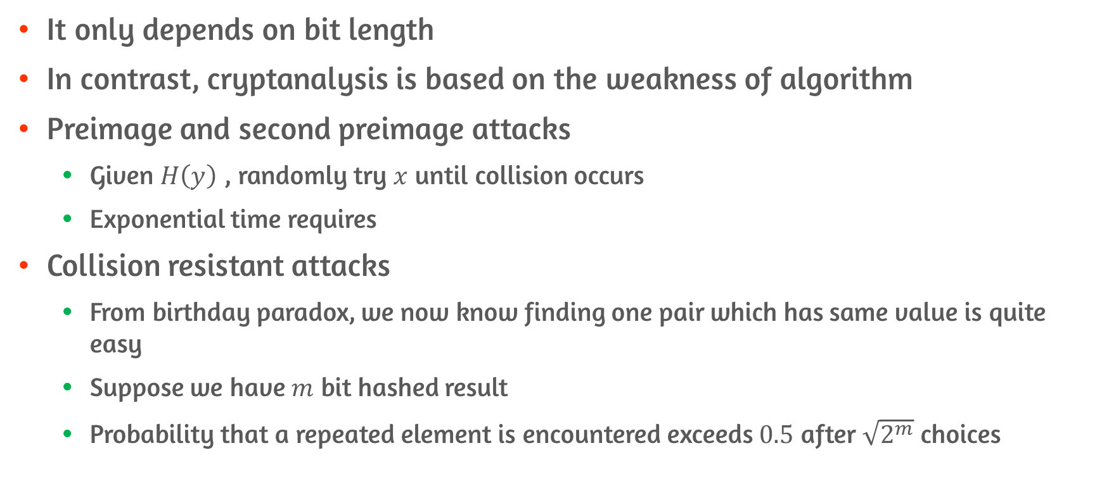
Brute-Force Attacks
It only depends on bit length
In contrast, cryptanalysis is based on the weakness of algorithm
Preimage and second preimage attacks
Given $H\left(y\right)$ , randomly try $x$ until collision occurs
Exponential time requires
Collision resistant attacks
From birthday paradox, we now know finding one pair which has same value is quite easy
Suppose we have $m$ bit hashed result
Probability that a repeated element is encountered exceeds $0.5$ after $\sqrt{2^{m}}$ choices

Slide 20
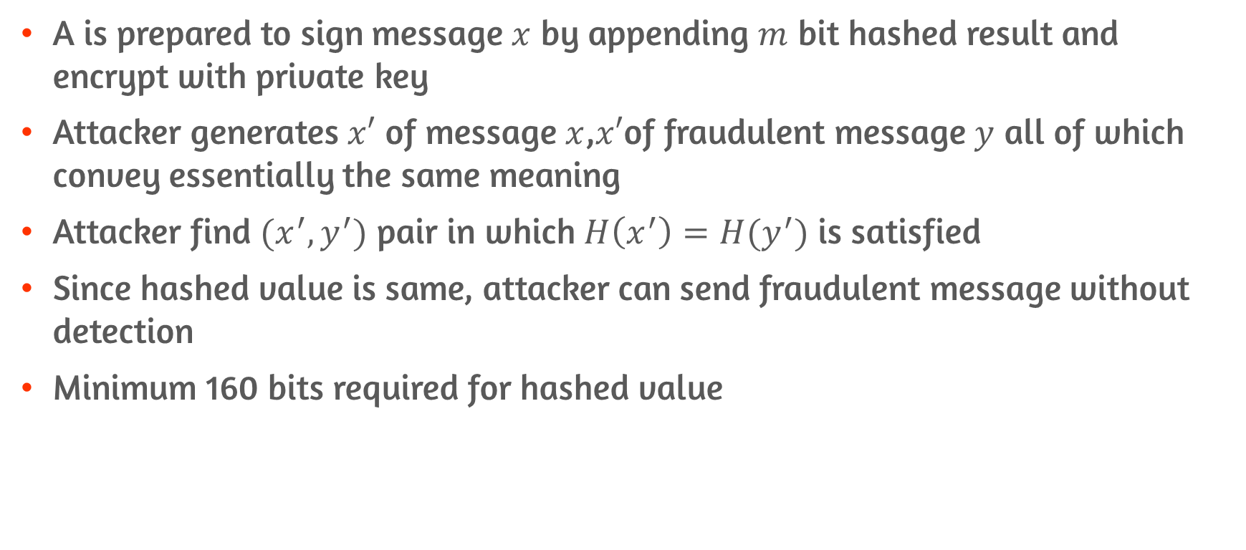
Collision Resistant Attacks
A is prepared to sign message $x$ by appending $m$ bit hashed result and encrypt with private key
Attacker generates $x′$ of message $x$,$x′$of fraudulent message $y$ all of which convey essentially the same meaning
Attacker find $(x^{′},y^{′})$ pair in which $H\left(x^{′}\right)=H(y^{′})$ is satisfied
Since hashed value is same, attacker can send fraudulent message without detection
Minimum 160 bits required for hashed value

Slide 21
Cryptanalysis
Instead of exhaustive search, cryptanalysis seek to weakness of the hashing algorithm
Cryptanalytic effort must be equal to or greater than brute force effort

Slide 22
11.4 Hash Functions Based on CBC

Slide 23
CBC

Slide 24
11.5 SHA

Slide 25
SHA-512 Logic #1

Slide 26
SHA-512 Logic #2

Slide 27
SHA-512 Logic #3

Slide 28
SHA-512 Round Function

Slide 29
Conclusion
Summarize the applications of cryptographic hash functions
Preimage resistant, second preimage resistant, collision resistant
Birthday paradox
Basic Structure of cryptographic hash functions
CBC hash functions
SHA-512

